Slide 1
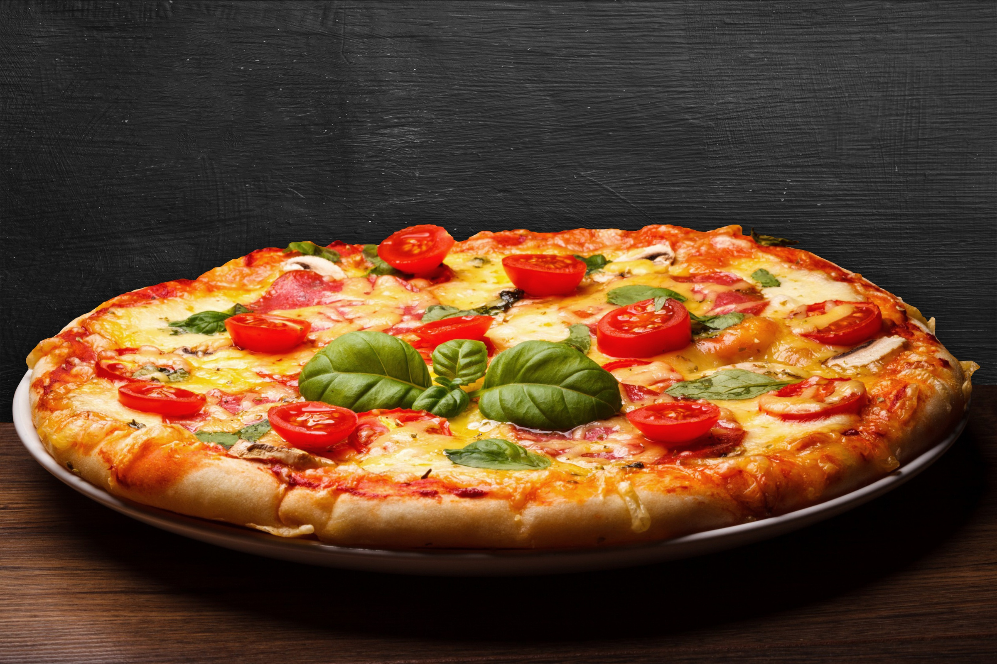

Pizza sales analysis
By MySQL

Slide 2




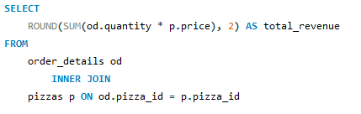

Retrieve the total number of orders placed.
Calculate the total revenue generated from pizza sales

Slide 3
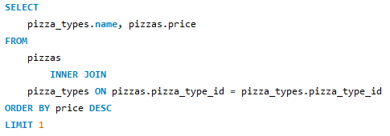

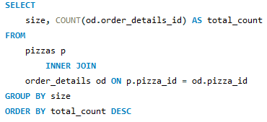
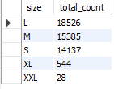
Identify the highest-priced pizza
Identify the most common pizza size ordered

Slide 4
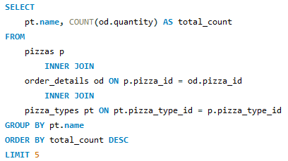
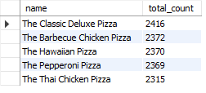
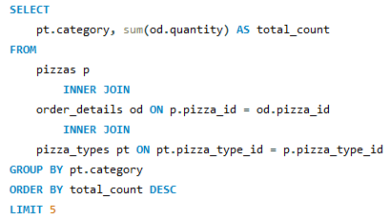

List the top 5 most ordered pizza types along with their quantities
Join the necessary tables to find the total quantity of each pizza category ordered

Slide 5
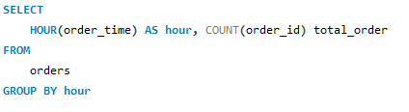
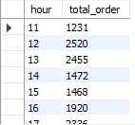
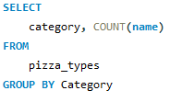
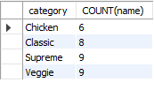
Determine the distribution of orders by hour of the day
Join relevant tables to find the category-wise distribution of pizzas

Slide 6
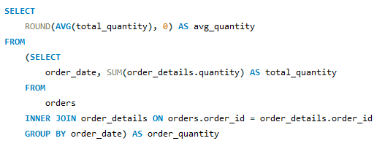

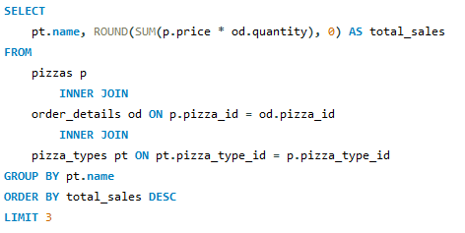

Group the orders by date and calculate the average number of pizzas ordered per day
Determine the top 3 most ordered pizza types based on revenue

Slide 7
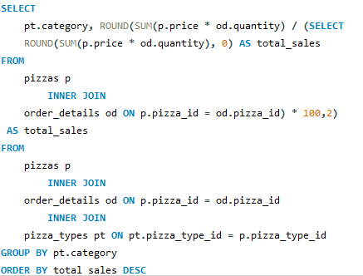

Calculate the percentage contribution of each pizza type to total revenue

Slide 8
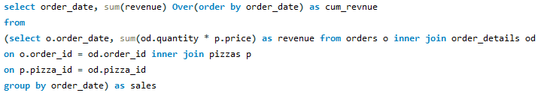
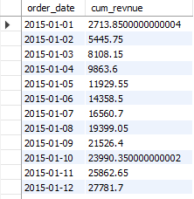
Analyze the cumulative revenue generated over time

Slide 9
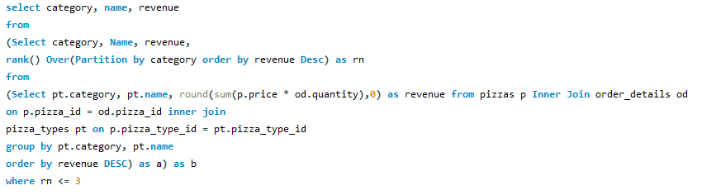
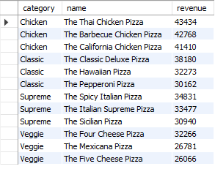
Determine the top 3 most ordered pizza types based on revenue for each pizza category

Slide 10

larana pizza
thank you!

